Slide 1
PRESENTED BY : Thenmugi T
REGISTER NO : 730321243029
DEPARTMENT : Artificial Intelligence and data Science
3/21/2024 Annual Review

Slide 2
PROJECT TITLE
VIDEO COLORIZER USING AI-DEEP LEARNING TECHNIQUE
3/21/2024 Annual Review

Slide 3


AGENDA
Problem Statement
Project Overview
Who are the end users?
Your solution and its value proposition
The wow in your solution
Modelling
Results

Slide 4

PROBLEM STATEMENT
The project aims to develop a video colorization system using AI deep learning techniques to accurately and realistically add color to black-and-white videos. The challenge lies in training a deep learning model to understand and apply natural colorization to grayscale footage, ensuring that the colors added are consistent, realistic, and enhance the visual appeal of the videos without distorting the original content.

Slide 5

PROJECT OVERVIEW
The project focuses on developing a video colorization system that utilizes AI deep learning techniques to add natural and realistic colors to black-and-white videos. By leveraging advanced algorithms and neural networks, the system aims to automate the colorization process, enhancing the visual appeal and storytelling capabilities of monochromatic footage.

Slide 6

WHO ARE THE END USERS?
1)Filmmakers and Video Editors: Professionals in the film industry who want to add color to black-and-white footage for artistic or historical purposes.
2)Historians and Archivists: Individuals or organizations looking to revitalize and preserve historical videos by adding color to enhance their visual appeal.
3)Content Creators: Online creators, YouTubers, and social media influencers interested in transforming their videos with vibrant colors for increased engagement.
4)Photographers and Artists: Visual artists seeking to experiment with colorizing their black-and-white creations to add a new dimension to their work.
5)General Public: Enthusiasts who enjoy exploring and experiencing the transformation of black-and-white videos into colorized versions for entertainment and educational purposes.

Slide 7

YOUR SOLUTION AND ITS VALUE PROPOSITION
SOLUTION:
By leveraging advanced algorithms and neural networks, the system will intelligently remap colors to create lifelike representations of the original scenes without the need for manual intervention. Through the integration of deep learning models and user-friendly interfaces, the solution will streamline the colorization process, offering efficiency, accuracy, and high-quality results.
VALUE PROPOSITION:
Effortless Colorization
Realistic Colorization
Historical Preservation
Enhanced Storytelling
User Satisfaction

Slide 8

THE WOW IN YOUR SOLUTION
The "WOW" factor in our video colorizer project, which is AI deep learning-based, lies in the ability to seamlessly and realistically add natural colors to black-and-white videos, transforming them into vibrant and engaging visual content. By harnessing the power of advanced AI algorithms and neural networks, our project can automate the colorization process, enhancing the storytelling capabilities and visual appeal of monochromatic footage with efficiency and accuracy. This WOW factor stems from the project's capacity to revolutionize the way black-and-white videos are transformed, offering users a tool that goes beyond traditional colorization methods to deliver stunning, life like results that captivate audiences and breathe new life into historical or artistic content.
8

Slide 9
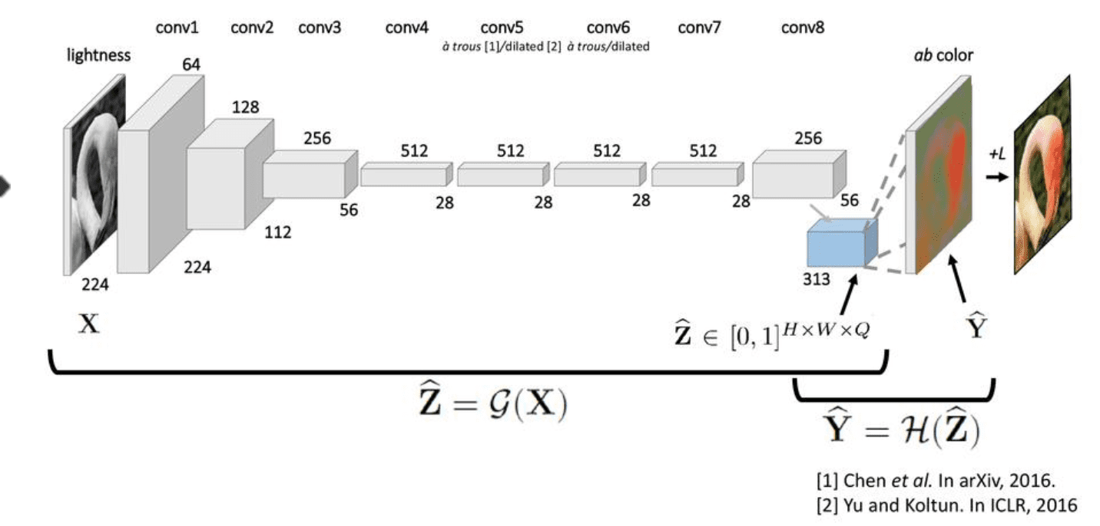
MODELLING
9

Slide 10
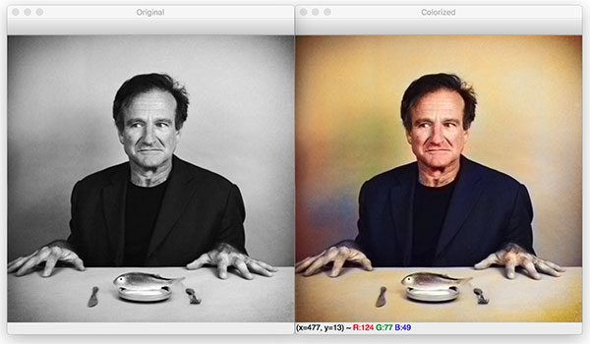
RESULTS
.
The result of your video colorizer project, which is AI deep learning-based, is the successful implementation of a system that can automatically and realistically add colors to black-and-white images and videos. The outcome of your project is to provide users with a tool that can efficiently and accurately colorize black-and-white videos, enhancing their visual appeal and storytelling capabilities.
Demo Link: https://github.com/Thenmugi/naanmudhalvan.git
10

